Slide 1
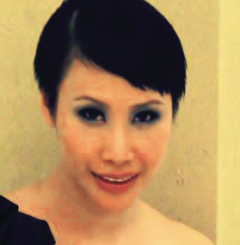
Motives®秋冬浪漫魅力
Motives® by Loren Ridinger A/W Collection
Angie Chou
主管經理級經銷商 Master Coordinator
四個佣金週期共賺取HK$16,100
HK$16,100 in 4 Commission weeks
本簡報中提到的收入等級純屬舉例說明，無意代表美安香港經銷商的一般收入，也無意表示任何經銷商皆可賺取同等收入。美安香港經銷商的成功與否，取決於其在發展事業時的努力、才能與投入程度。The income levels mentioned in the following presentation are for illustration purposes only. They are not intended to represent the income of a typical Market Hong Kong Distributor, nor are they intended to represent that any given Independent Distributor will earn income in that amount. The success of any Market Hong Kong Independent Distributor will depend upon the amount of hard work, talent, and dedication which he or she devotes to building his or her Market Hong Kong Business.

Slide 4
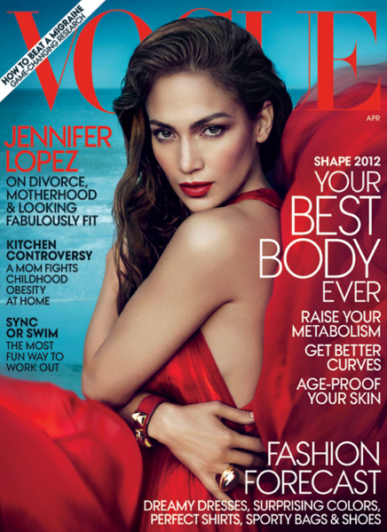
Motives® By Loren Ridinger®獲媒體廣泛報導：
Motives® By Loren Ridinger® has been featured in:

Slide 5
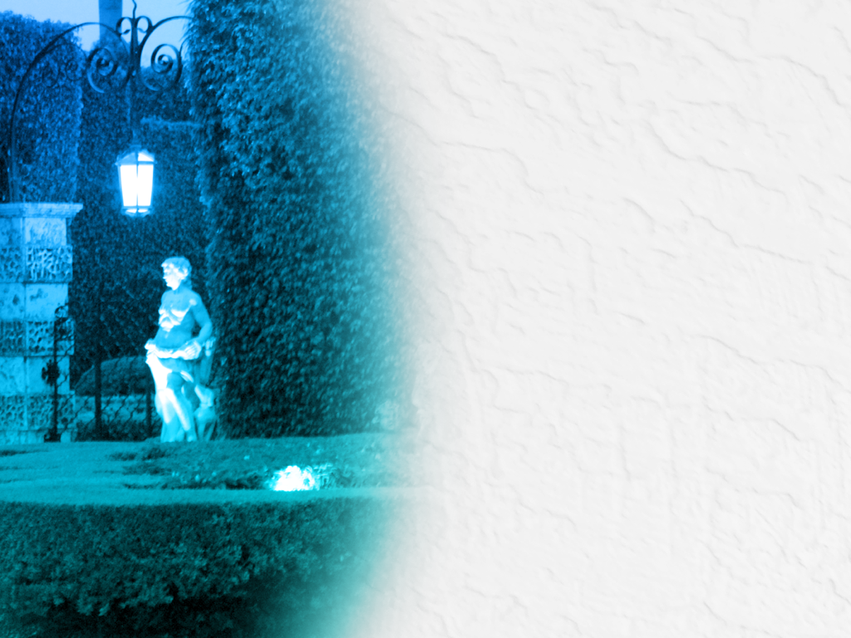
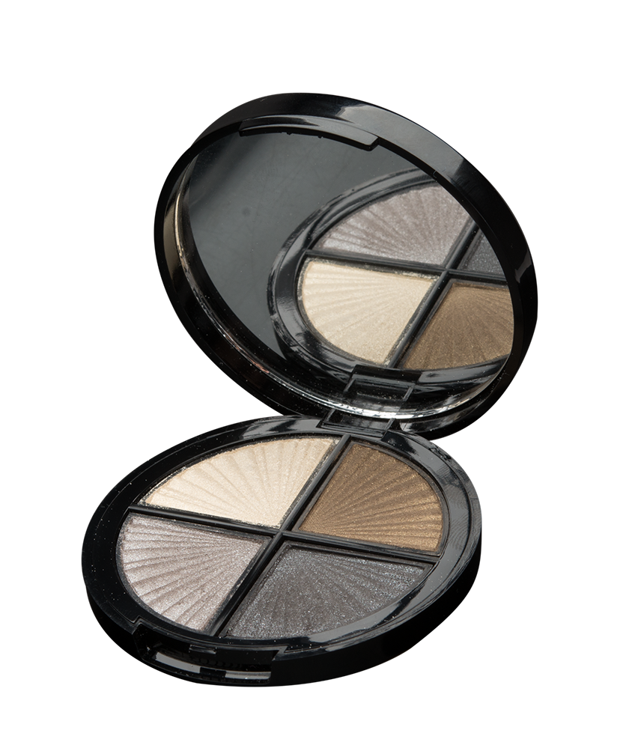
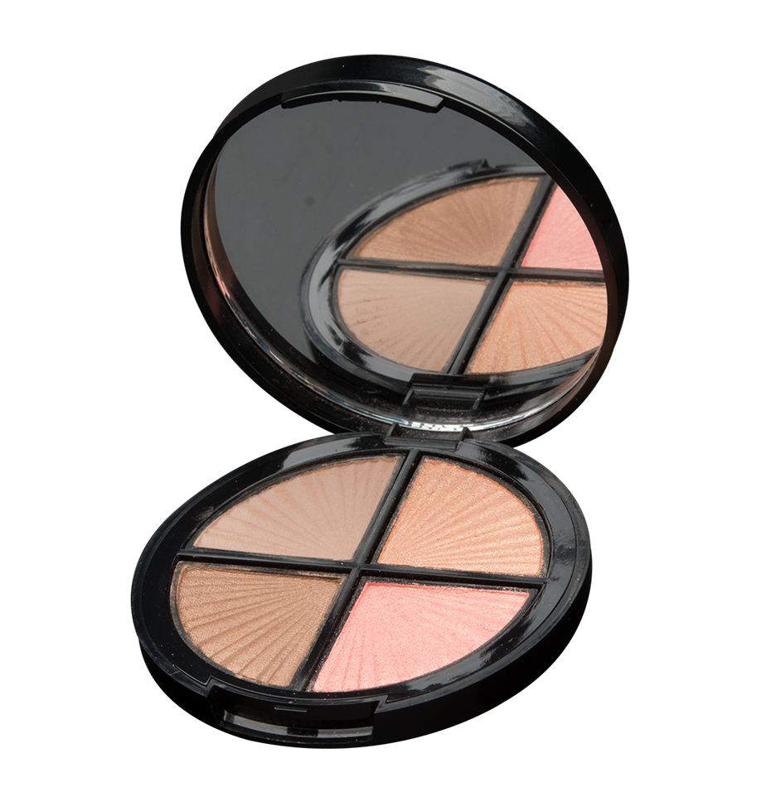
節日四色眼影組合 HOLIDAY QUADS
HKPRESH10-First Date
HKPRESH11-Late Night
DC:$185.00 SR:$260.00 BV:17

Slide 6
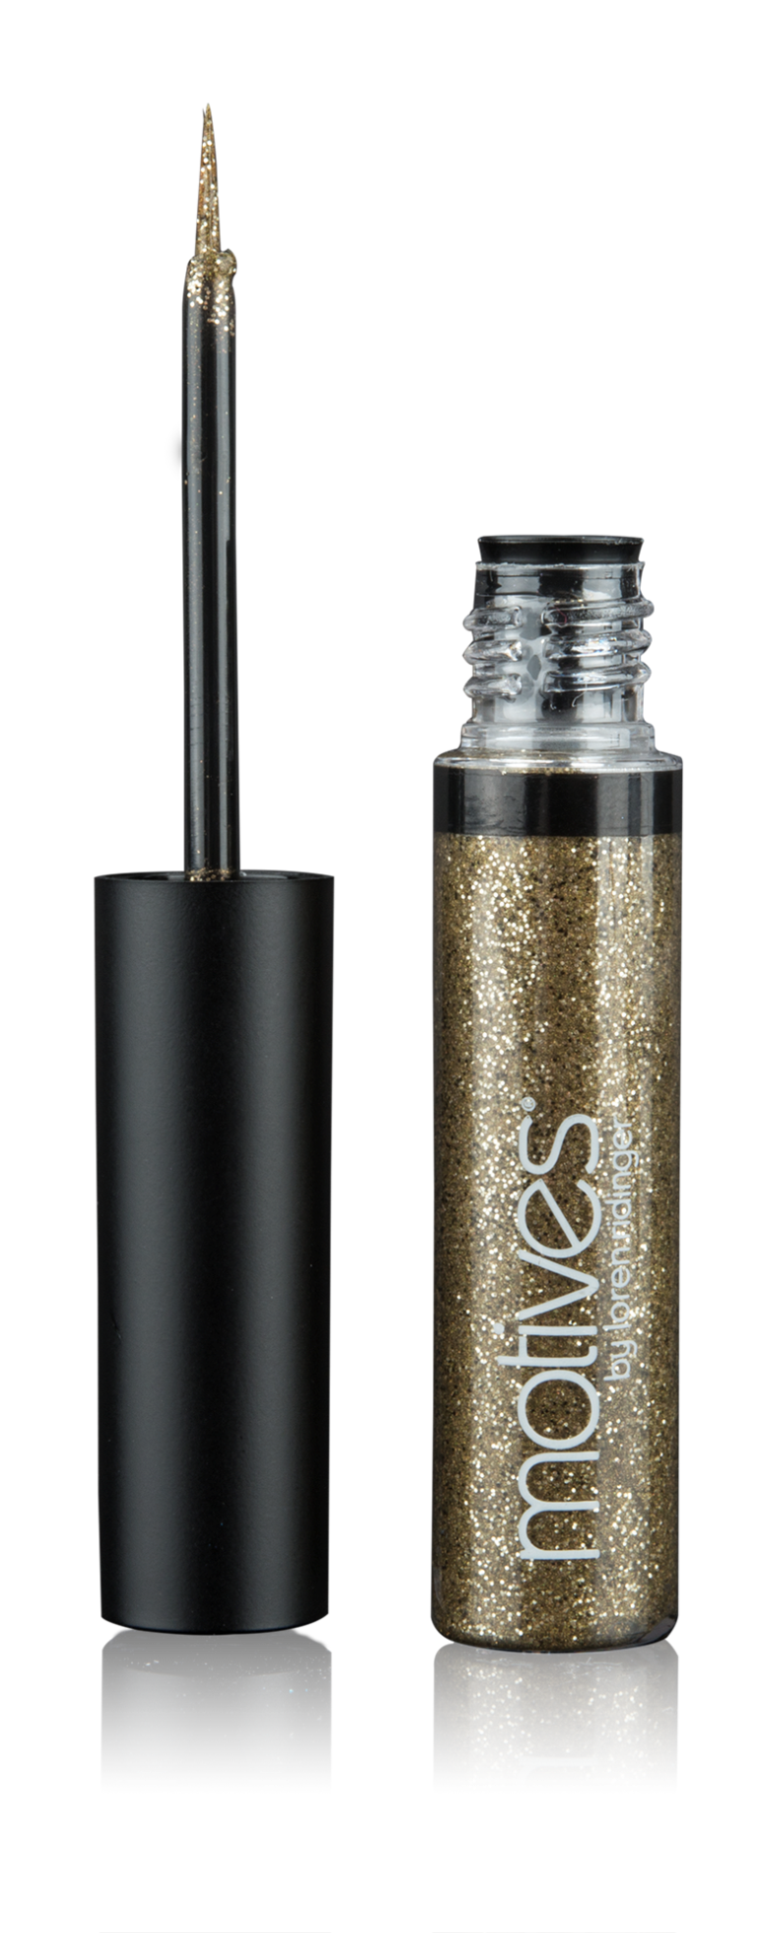
閃爍眼線液 GLITTER EYELINER - Gold Digger
HK101MGE
DC:$ 85.00 SR:$ 120.00 BV:7.5

Slide 7
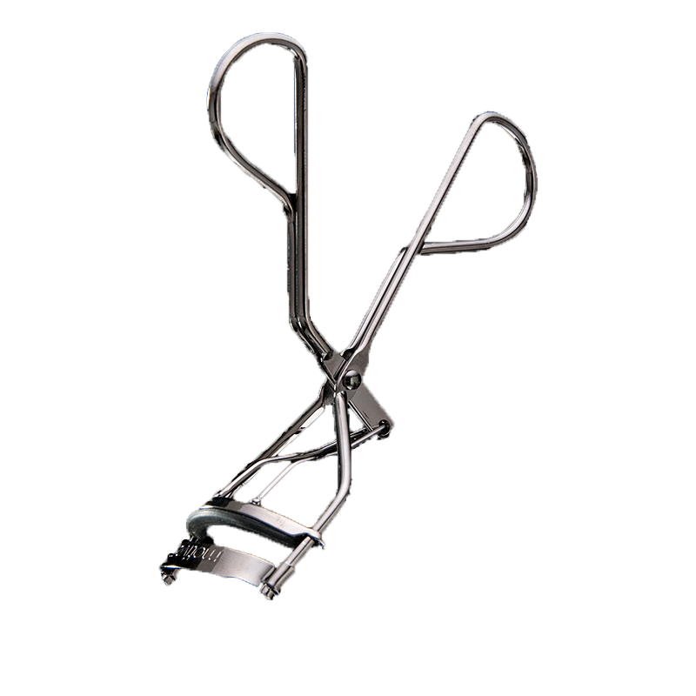
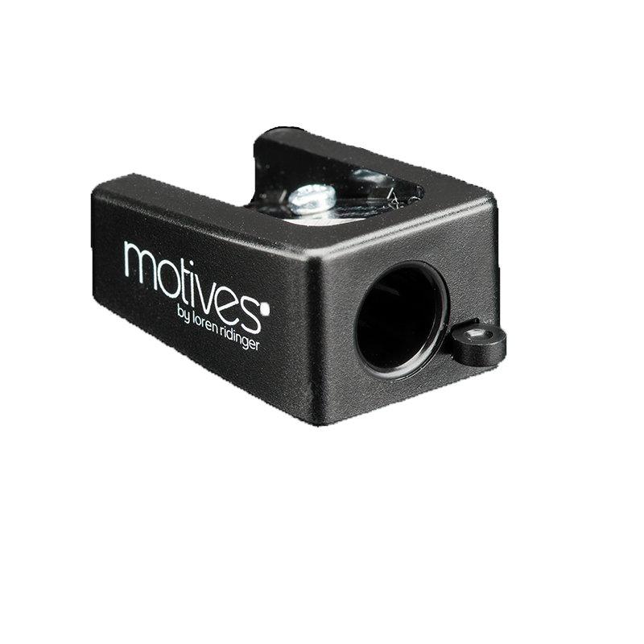
工具 TOOLS
化妝專用筆刨
Pencil Sharpener
捲翹睫毛夾
Eye Lash Curler
HKX9005
HK20128
DC:$23.00
SR:$33.00
BV:0
DC:$65.00
SR:$90.00
BV:6

Slide 8
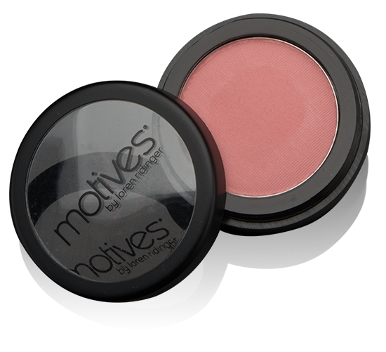
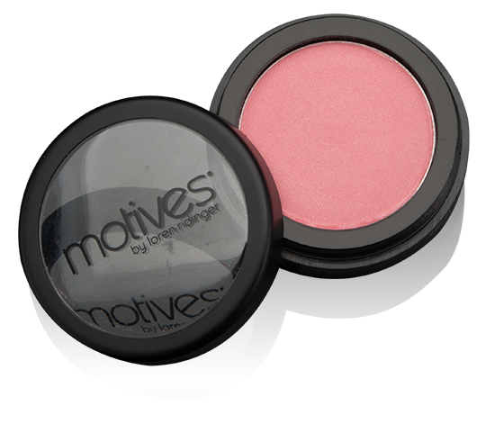
礦物胭脂 MINERAL BLUSH
HK104MPB- Pink Mauve
HK105MPB- Empress
DC:$99.00 SR:$139.00 BV:8.5

Slide 9
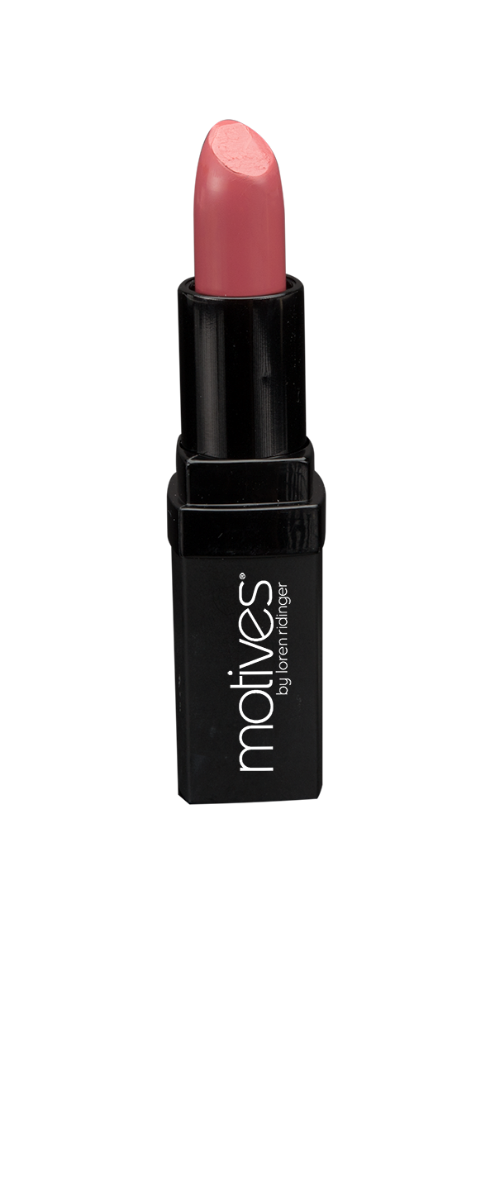
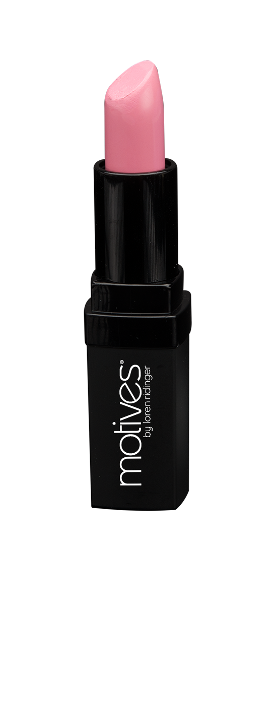
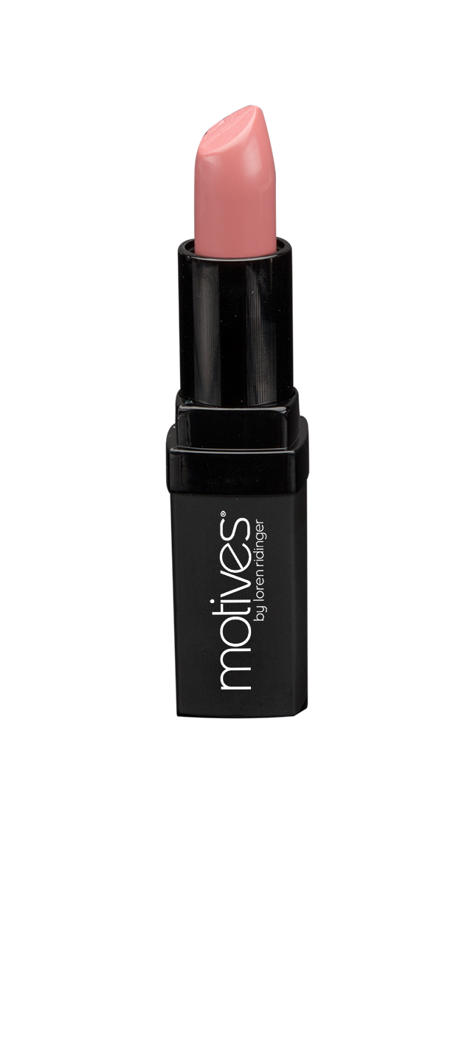
礦物唇膏 MINERAL LIPSTICK
HK111ML-Rosewood
HK112ML-Petal Pink
HK113ML-Rose Berry
DC:$110.00 SR:$155.00 BV:9.5

Slide 10
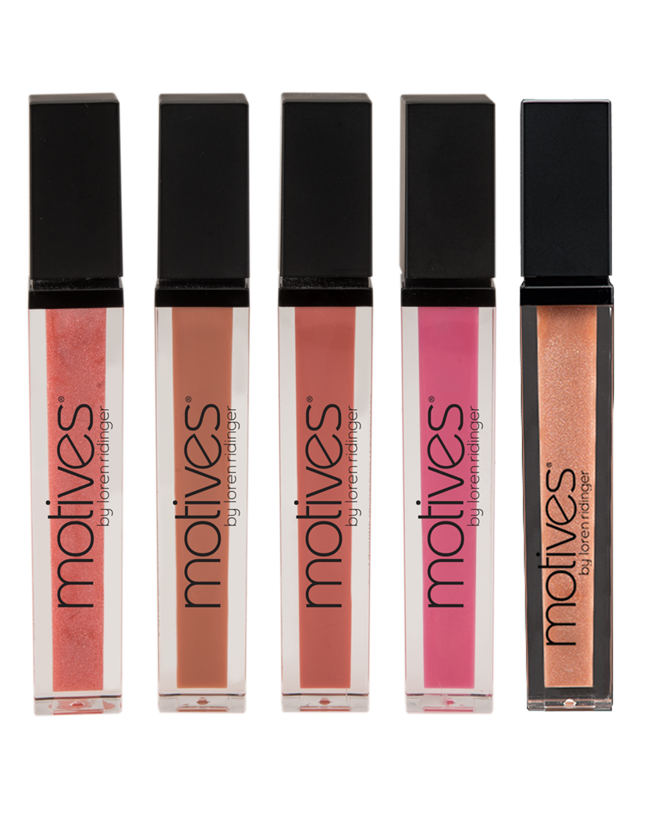
礦物唇彩 MINERAL LIPSHINE
HK49MLG- Scandal
HK50MLG- Toasty Delight
HK51MLG- Adore Me
HK52MLG- Rosé
HK58MLG- Kiss Me
DC:$125.00 SR:$175.00 BV:9

Slide 11
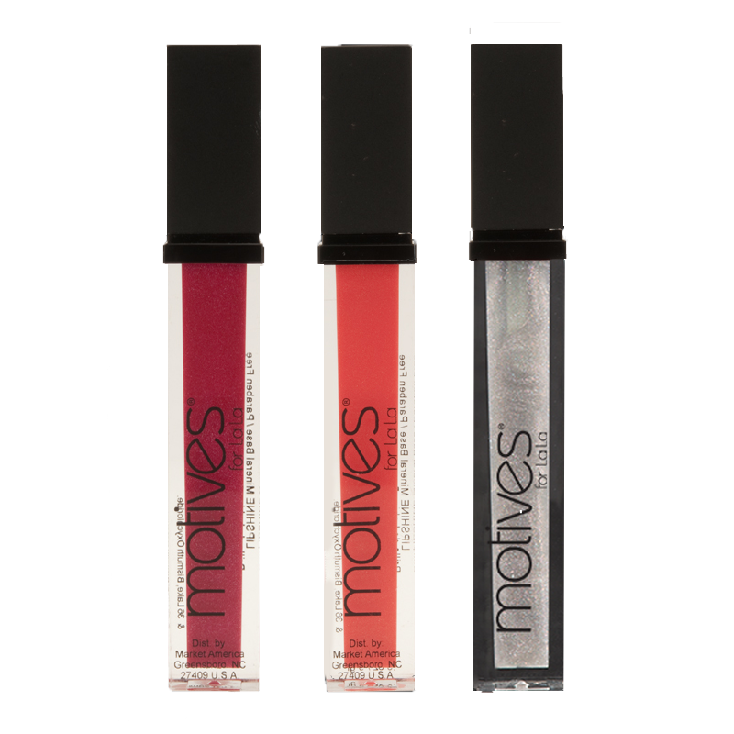
LA LA 礦物唇彩 LA LA MINERAL LIPSHINE
HK101MLMG - Trend Setter
HK105MLMG - Gossip
HK115MLMG - Passion
DC:$125.00 SR:$175.00 BV:9

Slide 12
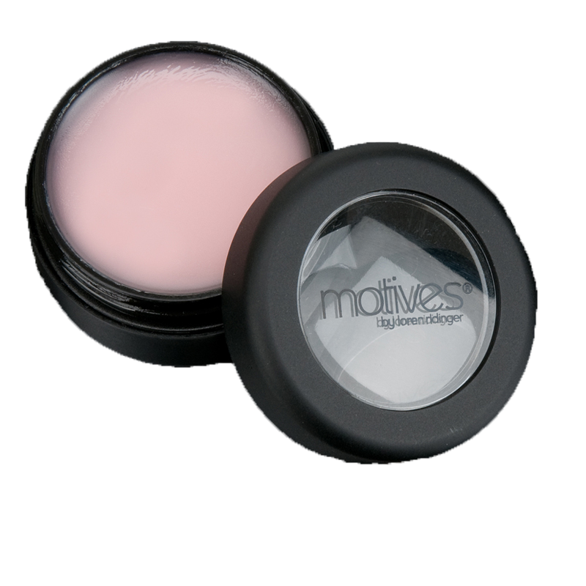
40FY豐盈修護唇膏 40Fy Lip Treatment
HK499MLT
DC:$128.00 SR:$179.00 BV:12

Slide 13
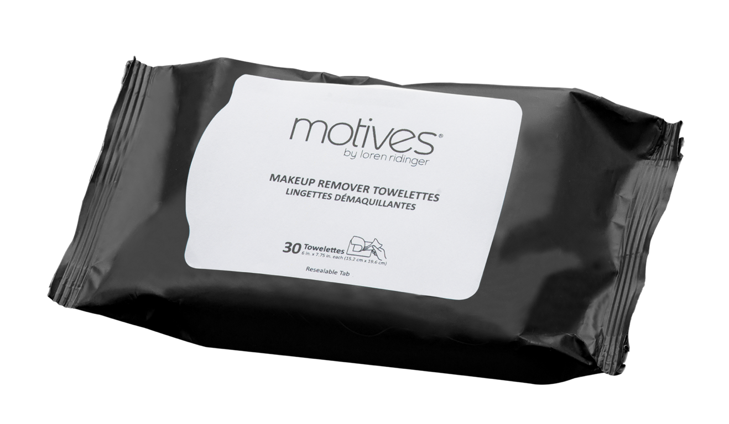
卸妝潔面紙 MAKEUP REMOVER TOWELETTES
HK01MEMT
DC:$42.00 SR:$59.00 BV:2

Slide 14
持久絕色指甲油 NAIL LACQUER
HK5424MNP- If You Dare
HK5425MNP- Crave
HK5426MNP- Exposed
HK5008MNP- Venom
HK5009MNP- Jaded
DC:$50.00 SR:$70.00 BV:3.5

Slide 15
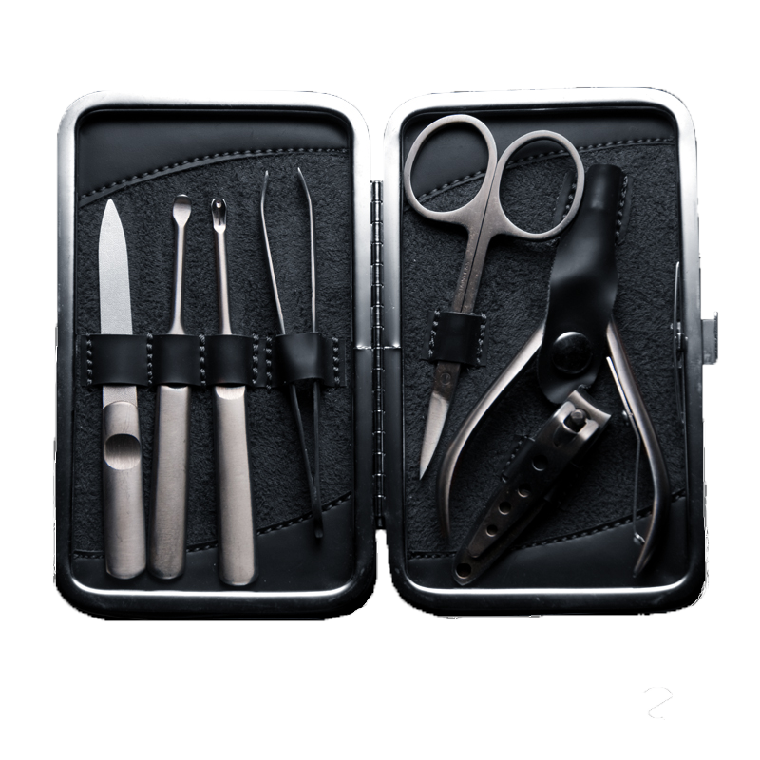
專業美甲修容組合 PROFESSIONAL
NAIL CARE KIT
HK100MNA
DC:$182.00 SR:$255.00 BV:16

Slide 16
日妝 Day
底妝 Priming and Base
無瑕美肌妝前底霜 Perfecting Face Primer
礦物粉底液 SPF 15 Liquid Powder Mineral Foundation SPF 15 – Cream Beige
全方位高清粉餅 Full Coverage Photo Finish Powder – Neutral
眼部 Eyes
無瑕美肌眼部底霜 Eye Base
節日四色眼影組合 Holiday Quads – Late Night*
唇部 Lips
礦物唇膏 Mineral Lipstick – Petal Pink*
La La 礦物唇彩 Mineral Lip Shine – Passion*
面頰 Face
礦物胭脂 Mineral Blush – Pink Mauve*
修容 Touch Up
瞬間無瑕定妝噴霧 10 Years Younger Makeup Setting Spray
* 新產品 New Product

Slide 17
晚妝 Night
底妝 Priming and Base
無瑕美肌妝前底霜 Perfecting Face Primer
礦物粉底液 SPF 15 Liquid Powder Mineral Foundation SPF 15 – Tender Beige
全方位高清粉餅 Full Coverage Photo Finish Powder – Neutral Medium
眼部 Eyes
甜心眼影膏 Eye Candy Crème Shadow – Butterscotch
節日四色眼影組合 Holiday Quads – First Date*
閃爍眼線液 Glitter Eyeliner – Gold Digger*
唇部 Lips
極緻滋潤唇膏 Rich Formula Lipstick – Go Red
La La 礦物唇彩 Lip Shine – Gossip*
面頰 Face
雙色修容組合 Blush Bronzer Duo
礦物胭脂 Mineral Blush – Empress*
修容 Touch Up
瞬間無瑕定妝噴霧 10 Years Younger Makeup Setting Spray
* 新產品 New Product

Slide 18
新娘妝
On Bride
底妝 Priming and Base
無瑕美肌妝前底霜 Perfecting Face Primer
礦物粉底液 SPF 15 Liquid Powder Mineral Foundation SPF 15 – Cream Beige
全方位高清粉餅 Full Coverage Photo Finish Powder – Neutral
眼部 Eyes
甜心眼影膏 Eye Candy Crème Shadow – Gum Drop
節日四色眼影組合 Holiday Quads – First Date*
礦物烘焙雙效眼影組合 Mineral Baked Eye Shadow Trio – Impatient
閃爍眼線液 Glitter Eyeliner – Starry Eyes*
唇部 Lips
礦物唇膏 Mineral Lipstick – Petal Pink*
礦物唇彩 Mineral Lip Shine – Rosé*
面頰 Face
礦物胭脂 Mineral Blush – Pink Mauve*
修容 Touch Up
HK301FS 瞬間無瑕定妝噴霧 10 Years Younger Makeup Setting Spray
* 新產品 New Product

Slide 19
新郎妝
On Groom
底妝 Priming and Base
無瑕美肌妝前底霜 Perfecting Face Primer
礦物粉底液 SPF 15 Liquid Powder Mineral Foundation SPF 15 – Sandy Beige
眉妝 Brows
眉妝組合 Essential Brow Kit
唇部 Lips
維他命E修護唇膏 Vitamin E Lip Treatment
面頰 Face
雙色修容組合 Blush Bronzer Duo
修容 Touch Up
瞬間無瑕定妝噴霧 10 Years Younger Makeup Setting Spray

Slide 20
伴娘妝
On Bridesmaid
底妝 Priming and Base
無瑕美肌妝前底霜 Perfecting Face Primer
礦物粉底液 SPF 15 Liquid Powder Mineral Foundation SPF 15 – Cream Beige
全方位高清粉餅 Full Coverage Photo Finish Powder – Neutral
眼妝 Eyes
無瑕美肌眼部底霜 Eye Base
節日四色眼影組合 Holiday Quads – First Date*
眼影 Pressed Eyeshadow – Pink Diamond
唇部 Lips
礦物唇膏 Mineral Lipstick – Rosewood*
礦物唇彩 Mineral Lip Shine – Scandal*
面頰 Face
礦物胭脂 Mineral Blush – Pink Mauve*
修容 Touch Up
瞬間無瑕定妝噴霧 10 Years Younger Makeup Setting Spray
* 新產品 New Product

Slide 21
伴郎妝
On Groomsman
底妝 Priming and Base
無瑕美肌妝前底霜 Perfecting Face Primer
礦物粉底液 SPF 15 Liquid Powder Mineral Foundation SPF 15 – Tender Beige
眉妝 Brows
眉妝組合 Essential Brow Kit
唇妝 Lips
維他命E修護唇膏 Vitamin E Lip Treatment
面頰 Face
雙色修容組合 Blush Bronzer Duo
修容 Touch Up
瞬間無瑕定妝噴霧 10 Years Younger Makeup Setting Spray

Slide 22
.
Notes:
22

